Slide 1


Hope Tladi
20 March 2025

Slide 2

Outline
Executive Summary 3
Introduction 4
Methodology 5
Results 16
Conclusion 45
Appendix 46

Slide 3
Executive Summary
Summary of methodologies
This study utilizes historical launch data from the SpaceX REST API to predict the success of Falcon 9 stage 1 landings. Data preprocessing was performed before training multiple machine learning models, including Logistic Regression, K-Nearest Neighbors (KNN), Decision Tree, and Support Vector Machine (SVM). These models were evaluated based on their accuracy in predicting landing success.
Summary of all results
The Logistic Regression and KNN models all achieved an accuracy of 94%, while the SVM model and Decision Tree performed slightly worse, with 88% accuracy. Analysis identified Launch Site, Payload Mass, and Orbit as the most important predictors of landing success. Future improvements could incorporate weather conditions and real-time telemetry data to enhance predictive performance.

Slide 4
Introduction
The Falcon 9 rocket, developed by SpaceX, has revolutionized spaceflight with its groundbreaking reusability. A key factor in its success is its ability to land and be reused, which significantly reduces launch costs and increases mission efficiency. Since achieving its first successful landing in 2015, Falcon 9 has completed numerous autonomous landings on both drone ships and landing pads.
This report examines whether a Falcon 9 first stage landing will be successful and then uses these findings to predict launch costs based on landing outcomes, This information is useful for alternate companies that might be interested in bidding against Space X for a rocket launch.

Slide 5

Section 1

Slide 6
Methodology
1.Data collection:
-Space X REST APIs.
-Web Scraping.
2.Data wrangling:
-handling missing and Duplicate data.
-Correct data types and standardize categorical variables.
3.Exploratory data analysis1 (EDA) using visualization and SQL with python:
-visualize relationship between key features and check yearly trends of the success rate of the landings.
4.Interactive visual analytics using Folium and Plotly Dash.
5.Predictive analysis using classification models: built four models namely knn,decision tree,svm and logistic regression for training and testing our data,the models were trained on 80% of the data and tested on unseen 20%.

Slide 7
Data Collection
The dataset for Space X Falcon 9 launches was collected using the Space X REST APIs, and to gather additional insights from external sources such as Space X’s official websites,Wikipedia, or news articles we used Web scraping.

Slide 8
Data Collection – SpaceX API
Query parameters: Filtered results for Falcon 9 launches.
JSON Response: Retrieved key data like launch success,payload mass and rocket version.
API Request: used Space X REST API (https://api.spacexdata.com/v4/launches) to fetch structered launch data.
Filter
Retrive
Fetch

Slide 9
Data Collection - Scraping
Web Scraping:
extracted Falcon 9 launch records HTML table from Wikipedia.
parsed the HTML response on a Beutiful Soup object.
created a pandas data frame from the Beutiful Soup object.
ectract
parse on Beutiful Soup
Pandas DataFrame

Slide 10
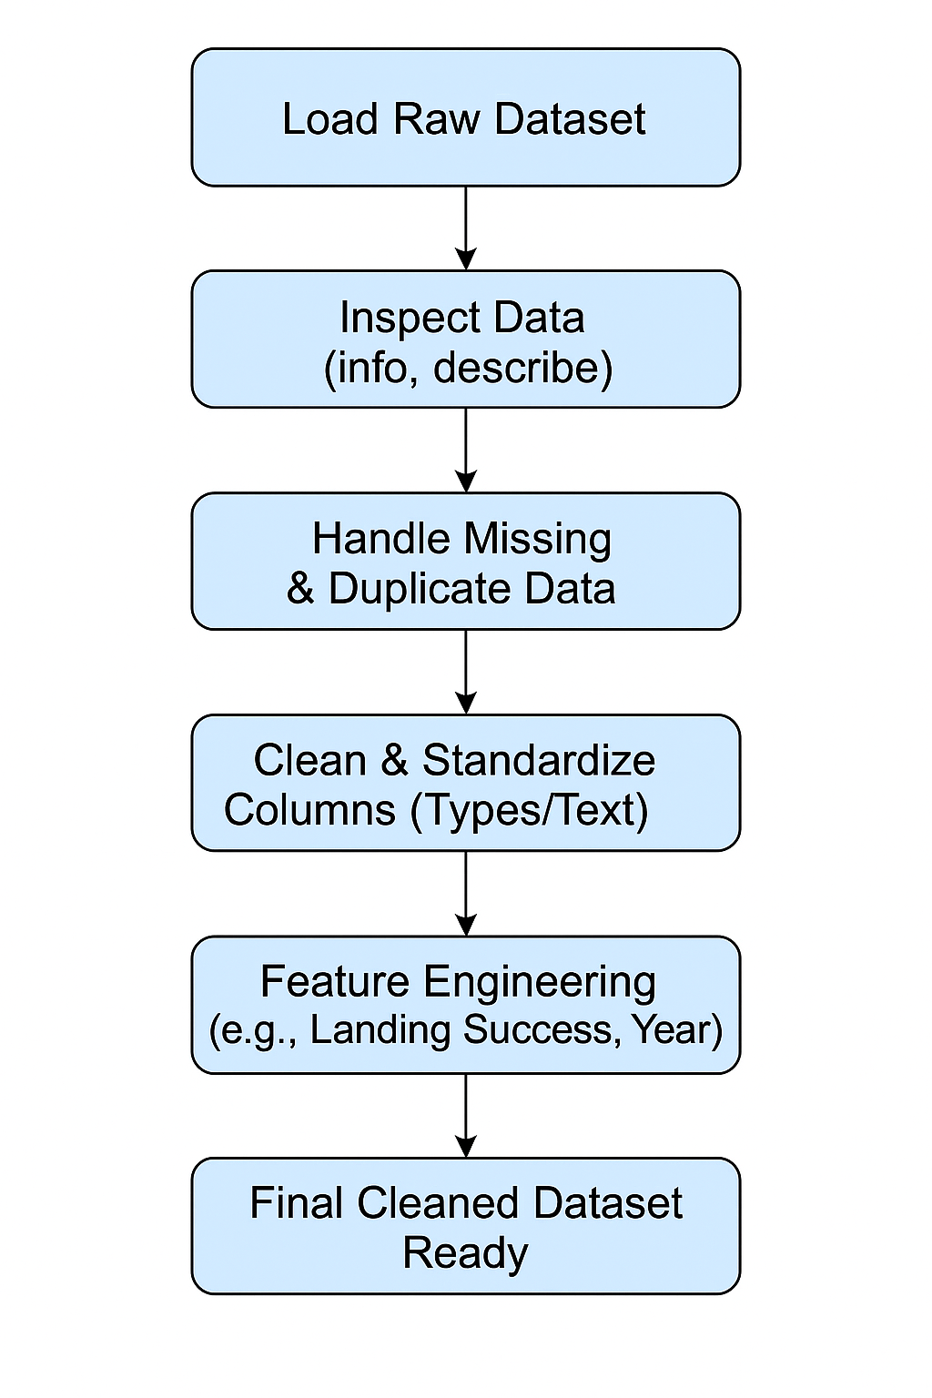
Data Wrangling
In this data wrangling process, the focus was on ensuring the dataset was clean and well-structured for both exploratory data analysis and machine learning modeling.
The process began with handling missing values, correcting data types, standardizing categorical variables, and resolving inconsistencies in string formatting. Additionally, new features such as launch year, orbit type, and a binary landing success indicator were engineered to enhance model performance and interpretability.
These steps provided a solid foundation for further analysis and prediction tasks.

Slide 11
EDA with Data Visualization
In this report, several visualizations were created to explore and understand the key factors affecting Falcon 9 landing success. The following charts were plotted:
1.Four scatter plots were created to understand the relationships between different features and how they might influence the landing outcome. These plots included:
-Flight Number vs. Launch Site – to observe how launches were distributed across various sites over time.
-Payload Mass vs. Launch Site – to analyze how payload capacities differed among launch locations.
-Flight Number vs. Orbit Type – to study how orbital destinations changed with SpaceX’s launch experience.
- to assess how payload mass varied across different orbit types.
2.Barchart(successrate by Orbit)- This chart helped identify which orbit missions had higher or lower success probabilities.
3.LineChart- was plotted with Year on the x-axis and average success rate on the y-axis to visualize how Falcon 9’s landing performance evolved over time.

Slide 12
EDA with SQL
Displaying the names of the unique launch sites in the space mission.
Displaying 5 records where launch sites begin with the string 'CCA’.
Displaying the total payload mass carried by boosters launched by NASA (CRS).
Displaying average payload mass carried by booster version F9 v1.1
Listing the date when the first succesful landing outcome in ground pad was acheived.
Listing the names of the boosters which have success in drone ship and have payload mass greater than 4000 but less than 6000.
Listing the total number of successful and failure mission outcomes.
Listing the names of the booster_versions which have carried the maximum payload mass. Using a subquery.
Listing the records which will display the month names, failure landing_outcomes in drone ship ,booster versions, launch_site for the months in year 2015.
Ranking the count of landing outcomes (such as Failure (drone ship) or Success (ground pad) between the date 2010-06-04 and 2017-03-20, in descending order.

Slide 13
Build an Interactive Map with Folium
Summarize what map objects such as markers, circles, lines, etc. you created and added to a folium map
Explain why you added those objects
Add the GitHub URL of your completed interactive map with Folium map, as an external reference and peer-review purpose

Slide 14
Build a Dashboard with Plotly Dash
Summarize what plots/graphs and interactions you have added to a dashboard
Explain why you added those plots and interactions
Add the GitHub URL of your completed Plotly Dash lab, as an external reference and peer-review purpose

Slide 15
Predictive Analysis (Classification)
Data Preprocessing-Converted categorical features (e.g., Launch Site, Booster Version Category, Orbit) using one-hot encodin,Split data into training and testing sets for model validation.
Model Building-Built and tested several classification models to predict landing outcomes namely Logistic Regression (baseline),Support Vector Machine (SVM),K-Nearest Neighbors (KNN),Random Forest Classifier.
Model Evaluation-Evaluated each model using Accuracy score,Classification report (Precision, Recall, F1-score),Confusion matrixs and Comparing performance to identify strengths and weaknesses.
Model Improvement-Applied GridSearchCV to tune hyperparameters for each model,C, solver for Logistic Regression,kernel, C, gamma for SVM,n_neighbors for KNN,n_estimators, max_depth for Random Forest,Used cross-validation to reduce overfitting and improve generalization.
Data preprocessing
Model Building
(Logreg,SVM,
KNN&RF)
Model Evaluation
(Accuracy,F1,ect)
Hyperparameter Tuning(GridSearch)
Selecting best Model

Slide 16
Results
The results are split into 3 sections:
1.Exploratory data analysis results(with SQL).
In all of the graphs that follow, class 0 represents a failed launch outcome while class 1 represents a successful launch outcome.
2.Interactive analytics demo in screenshots
Launchsite proximities analysis.
Dashboard with plotlydash.
3.Predictive analysis results.

Slide 17

Section 2

Slide 18
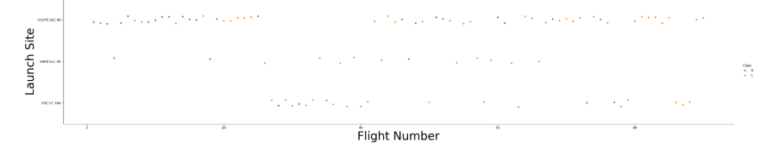
Flight Number VS. Launch Site
The blue dots in the above scatter point represent unsuccesful landings and the orange dots represent a succesful landing.
we can clearly see that for all the three different launchsites, as the flight number increases, more rockets tend to fall under the succesful class.

Slide 19
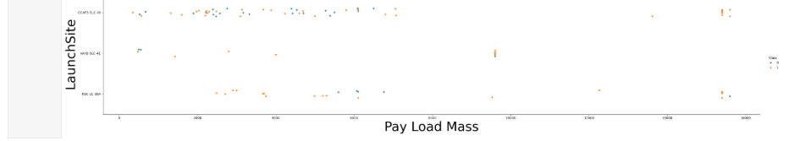
Payload vs. Launch Site
what we can observe from the scatter point above is that for each different launchsite there tends to be more succeful landings with an increasing payloadmass of a rocket.
meaning rockets with higher payloadmass tend to land succesfully at all the three different launchsites.

Slide 20
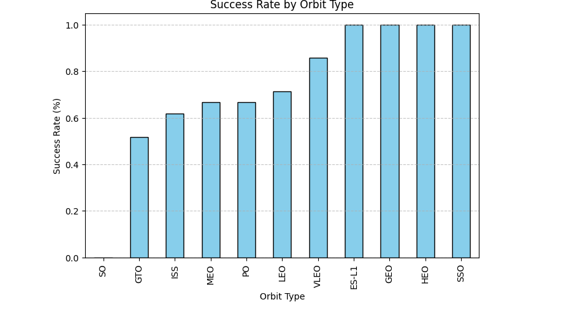
Success Rate vs. Orbit Type

Slide 21
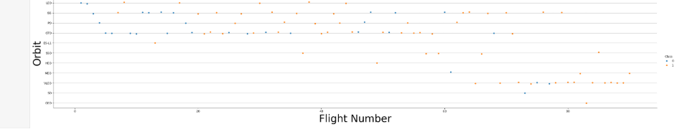
Flight Number vs. Orbit Type
We can observe that in the LEO orbit, success seems to be related to the number of flights. Conversely, in the GTO orbit, there appears to be no relationship between flight number and succes.

Slide 22
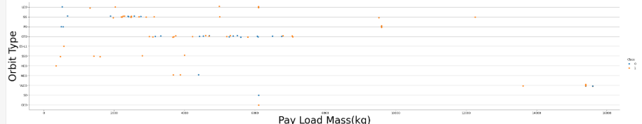
Payload vs. Orbit Type
With heavy payloads the successful landing or positive landing rate are more for Polar,LEO and ISS.
However, for GTO, it's difficult to distinguish between successful and unsuccessful landings as both outcomes are present.

Slide 23
Launch Success Yearly Trend

Slide 24
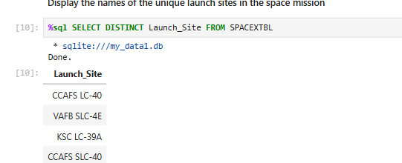
All Launch Site Names
To understand the distribution of SpaceX launches, we first identify the unique launch sites used. This helps in analyzing location-based patterns or preferences in launch activities.
Query Used:
%sql SELECT DISTINCT Launch_Site FROM SPACEXTBL
Result:

Slide 25
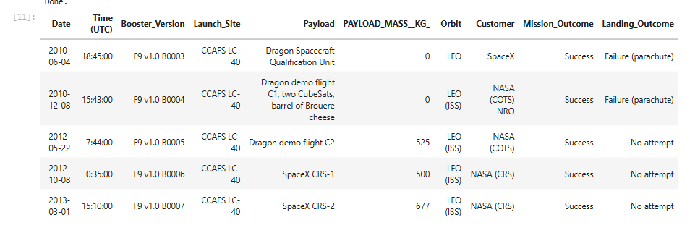
Launch Site Names Begin with 'CCA'
To analyze specific launch site activity, we filtered the dataset to only include sites beginning with "CCA" — representing Cape Canaveral Air Force Station, one of SpaceX’s most frequently used launch locations.
Query used: %sql SELECT * FROM SPACEXTBL WHERE Launch_site LIKE 'CCA%' LIMIT 5;
Result:

Slide 26
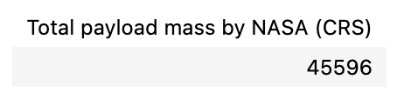
Total Payload Mass
To understand the contribution of NASA-related missions to SpaceX's launch history, we calculated the total payload mass carried on launches where NASA was a customer
Query used:
%sql SELECT SUM(PAYLOAD_MASS__KG_) AS Total_payload FROM SPACEXTBL WHERE Booster_Version LIKE 'NASA(CRS)%';
Result:

Slide 27
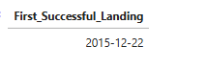
First Successful Ground Landing Date
To find the first successful ground pad landing (RTLS) by SpaceX, highlighting a key milestone in reusable rocket technology. This helps track the progress of SpaceX’s landing capabilities.
Query used:%sql SELECT MIN(Date) AS First_Successful_Landing FROM SPACEXTBL WHERE Landing_Outcome = 'Success (ground pad)';
Result:

Slide 28
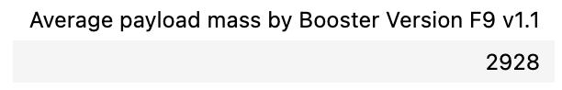
Average Payload Mass by F9 v1.1
To evaluate the performance of SpaceX’s Falcon 9 v1.1 booster version, we analyzed the average payload mass it carried across all launches using this version.
Query used:%sql SELECT AVG(PAYLOAD_MASS__KG_) AS Average_payload FROM SPACEXTBL WHERE Booster_Version = 'F9 v1.1';
Result:

Slide 29
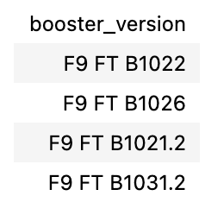
Successful Drone Ship Landing with Payload between 4000 and 6000
To show which booster versions successfully landed on drone ships with payloads between 4000–6000 kg, highlighting their reliability and performance under moderate payload conditions.
Query used:%sql SELECT DISTINCT "Booster_Version" FROM SPACEXTBL WHERE "Landing_Outcome" = 'Success' AND "Landing_Type" LIKE '%ASDS%' AND "Payload_Mass_kg_" > 4000 AND "Payload_Mass_kg_" < 6000;
Result:

Slide 30
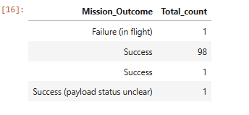
Total Number of Successful and Failure Mission Outcomes
This query summarizes how many SpaceX missions succeeded or failed, helping assess overall launch reliability and support further analysis.
Query used:%sql SELECT Mission_Outcome, COUNT(*) AS Total_count FROM SPACEXTBL GROUP BY Mission_Outcome;
Result:

Slide 31
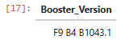
Boosters Carried Maximum Payload
This query identifies the booster versions that carried the maximum payload mass, highlighting SpaceX's most capable launch configurations and overall payload capacity.
Query used:%sql SELECT Booster_Version FROM SPACEXTBL WHERE payload =(SELECT MAX(payload) FROM SPACEXTBL);
Result:

Slide 32
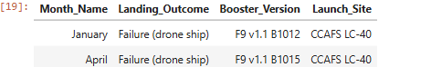
2015 Launch Records
This query retrieves details of failed Falcon 9 drone ship landings in 2015, showing the month, booster version, and launch site. It helps identify trends in failure patterns across months and booster types, providing insights into early reusability challenges. Month names are manually mapped due to SQLite's limitations.
Query used:%sql SELECT CASE substr(Date, 6, 2) WHEN '01' THEN 'January' WHEN '02' THEN 'February' WHEN '03' THEN 'March' WHEN '04' THEN 'April' WHEN '05' THEN 'May' WHEN '06' THEN 'June' WHEN '07' THEN 'July' WHEN '08' THEN 'August' WHEN '09' THEN 'September' WHEN '10' THEN 'October' WHEN '11' THEN 'November' WHEN '12' THEN 'December' END AS Month_Name,Landing_Outcome,Booster_Version,Launch_Site FROM SPACEXTBL WHERE substr(Date, 1, 4) = '2015' AND Landing_Outcome LIKE '%Failure (drone ship)%';
Result:

Slide 33
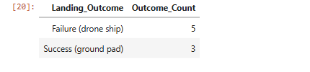
Ranking Landing Outcomes Between 2010-06-04 and 2017-03-20
This provides a clear snapshot of SpaceX’s early landing success rates and operational progression over time, supporting insights into the evolution of their landing technologies and mission strategies.
Query used:%sql SELECT Landing_Outcome,COUNT(*) AS Outcome_Count FROM SPACEXTBL WHERE Date BETWEEN '2010-06-04' AND '2017-03-20'AND (Landing_Outcome LIKE '%Failure (drone ship)%' OR Landing_Outcome LIKE '%Success (ground pad)%') GROUP BY Landing_Outcome ORDER BY Outcome_Count DESC;
Result:

Slide 34

Section 3

Slide 35

Map showing different Launchsites

Slide 36
Visualizing the launch sites in the screenshots was essential to understand the geographical distribution and strategic importance of the different facilities used for SpaceX Falcon 9 launches. By mapping the sites, we identified patterns in launch success rates across different facilities, aiding in more informed operational planning and recovery efforts.

Slide 37

Section 4

Slide 38

Dashboard

Slide 39

Section 5

Slide 40
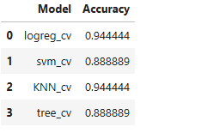
Classification Accuracy
this

Slide 41
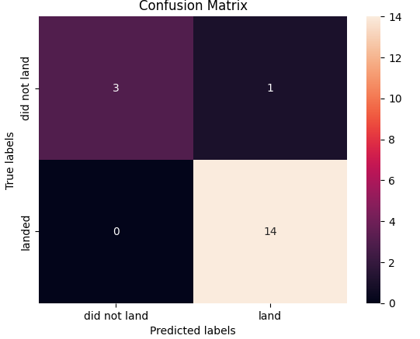
Confusion Matrix
This confusion matrix shows how well our model predicts whether a rocket lands or not.
The model correctly predicted that the rocket did not land 3 times.
The model incorrectly predicted that the rocket landed when it didn’t 1 time.
The model correctly predicted that the rocket landed 14 times.
The model never incorrectly predicted that the rocket did not land when it actually did.
This means the model is pretty good at predicting landings, with only one mistake in predicting that a rocket landed when it didn’t.

Slide 42
Conclusions
This report demonstrate that:
machine learning can effectively predict Falcon 9 landing success using historical launch data.
Flight Number, Payload mass,Launchsite and Orbit type are the most influential factors.
Three models namely Logistic Regression,KNN neighbour and Decision Tree perfomed well achieving 94% accuracy ,showing strong predictive power
Future improvement would include weather conditions and telementry data for an even more accurate model.

Slide 43
Appendix
Include any relevant assets like Python code snippets, SQL queries, charts, Notebook outputs, or data sets that you may have created during this project
(a)SPACEX REST API documentation
API URL: https://api.spacexdata.com
Endpoints used:
./v4/launches-Historical launch data
./v4/rockets- Booster version details
(b)ChatGPT and other AI sources/models.

Slide 44


